Slide 1
DHU visit
03.02.22

Slide 2

What is DHU?
Derbyshire Health United has been providing NHS 111 services since 2010 to Derbyshire and the surrounding regions.
Since it began, it has expanded geographically and now includes Nottinghamshire, Northamptonshire, Leicestershire, Leicester, Rutland, Milton Keynes and Wiltshire. The provide the service for around 5 million people in England.
They have four call centres, we visited the site in central Derby.
They support LAS with contingency calls.
They took 1 million calls in 2015 and expect to take 2.5 million in 2022.

Slide 3
Purpose of visit

Slide 4
What was the purpose of our visit?
Observe 111 health advisors and 111 clinicians using clinical systems. With the key goal of understanding the entire workflow and actions being taken at each step.
Specifically observe the barriers and frustrations using current clinical systems in the context of patient encounter history and information flow.
Briefly speak to staff members to gain contact details / any feedback and then can follow up after the visit with remote interviews.
This deck includes the research insights from observation and follow-up remote interviews.

Slide 5
Planning for the visit

Slide 6
Planning steps
Initial research plan
Initial agreement from the site
Health & safety assessment review
NHS Digital lead user researcher discussion and approval
Detailed research plan and logistics
Details confirmation with the site

Slide 7
Research plan
Apart from the usual elements, the research plan should include a justification on why an in-person visit is required.
The research plan should focus on what processes or behaviours the researchers want to observe and what project objectives this will help to achieve.
Example research plan
Consideration: demand for 111 services remains high, potentially consider visiting on a quieter day.

Slide 8
Risk assessment
Risk assessment needs to be completed ahead of the visit and reviewed by the health & safety advisor, who can advise on any mitigation actions.
The assessment needs to cover travel, fire and COVID transmission risks, both to the NHS Digital staff and site employees. The assessment should reflect the site's COVID policies, for example how many dosages of COVID vaccine the user researchers and observers
Example risk assessment
Contact person: louise.boothroyd1@nhs.net

Slide 9
After the visit

Slide 10
Follow-up (17.2.22)
Interviewed three health advisors, two clinicians and the senior operations performance manager
Specific questions around our observations from the DHU visit
Clarifying questions
First round of prototype feedback (not included in this slide deck)

Slide 11
Observations and insights

Slide 12
Systems and set-up
DHU use Adastra
When a patient rings 111 and come through to DHU they have options on the IVR before getting through to a member of staff:
Dental
Repeat prescriptions
Unwell or worsening
Waiting for call back
Need medication enquiry or health info (no symptoms)
Patient with a care plan
They also have an option at the beginning which identifies patients <5 years
All IVR options go through to the same call centre but some go to specialist teams e.g. Dental or mental health

Slide 13
Systems and set-up
All health advisors and clinicians have two screens.
One screen runs the Adastra system with the Pathways triage, clinical queue and seeing which clinicians are available. The second screen is used for all sorts of things: googling patient’s location, service finder, emails, toxbase, looking up controlled drugs on the government website
DHU use Adastra however, they can book patients into services that use Adastra, EMIS, SystmOne and other ED systems e.g., UTCs, GP surgeries, OOHs etc.
DHU clinicians have access to GP connect.
Calls are prioritised into 4 categories based on the disposition.

Slide 14
Workflow and Pathways
The health advisor's workflow is dictated by Pathways and standard operating procedures of the service. We have observed that add additional notes were added where necessary.
Health advisors will talk, write and speak at the same time, deleting their notes as the conversation progresses and information changes. They communicate with other members of the team via phone (putting patients on hold), after checking who is available.
They will always ask if there is someone with the caller.
Each time a call was ending, call handler ticked to say worsening advice was given.
The clinicians also use Pathways but have more freedom to ask additional questions .
Clinicians either call patients back from the clinical queue, advise health advisors when necessary or are transferred patients straight from a health advisor (warm transfer)

Slide 15
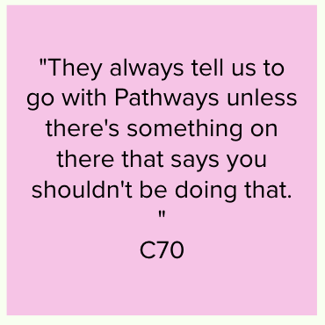
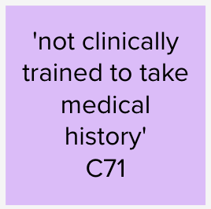
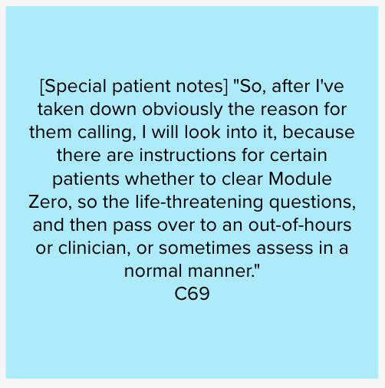
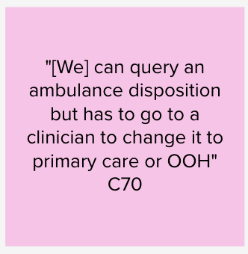
Workflow and Pathways

Slide 16
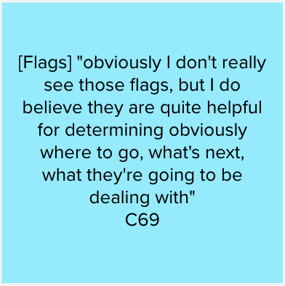
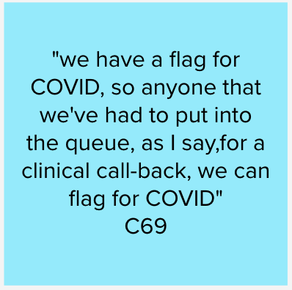
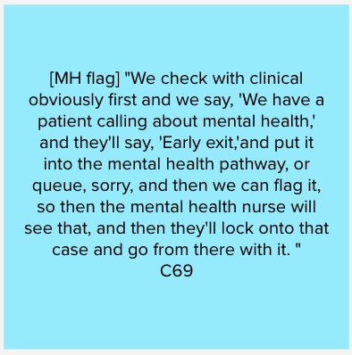
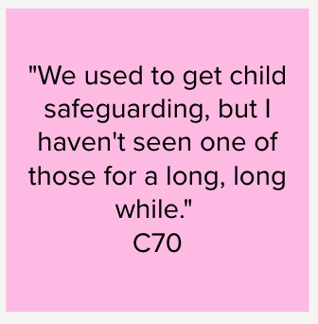
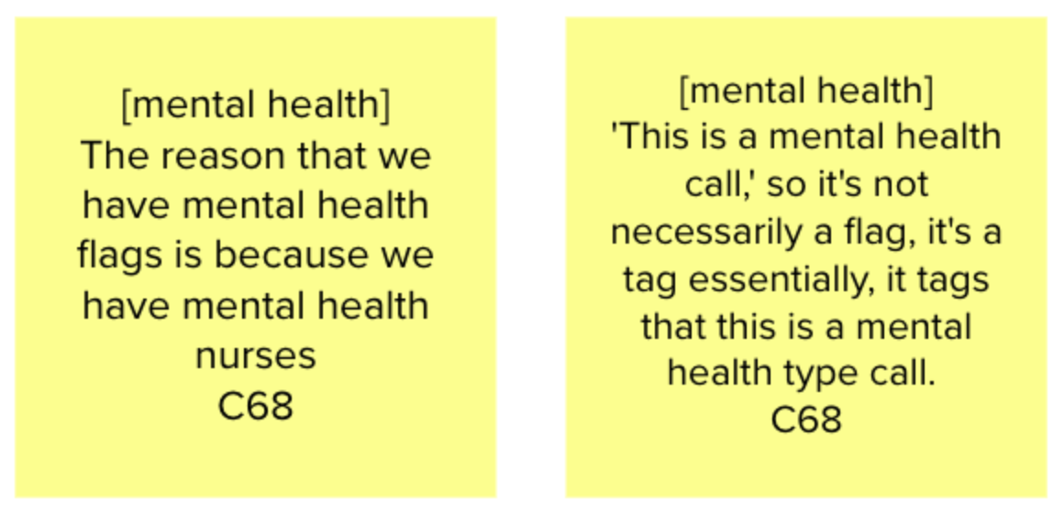
Flags and their usage
Within DHU there are flags for toxic ingestion, covid, mental health, safeguarding. Other settings may flag different conditions and in a different way
The mental health flag is associated with a call, not with a patient. It is assigned based on disposition (DHU has decided which dispositions are related to mental health). This helps them to route calls - these will likely be picked up by the mental health nurses.

Slide 17
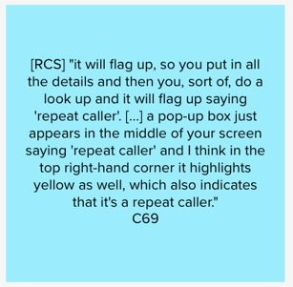
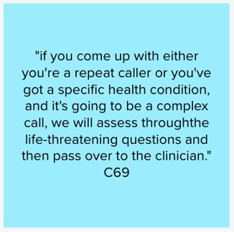

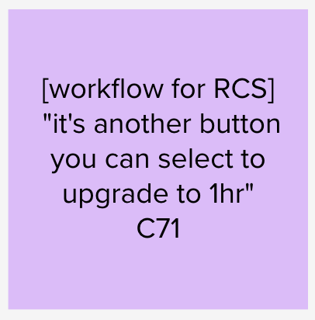
Repeat Caller Service (RCS)
RCS flag doesn’t have much impact on the workflow. A disposition upgrade is the only change, as the assessment runs as usual. The HA can query the upgrade with a clinician.

Slide 18
Frequent callers
Frequent callers can be:
Nuisance callers
People getting into a loop as they are unable to get care (dental or GP appointments being the most common).
Most frequent callers are nuisance callers. We heard of people using many phones to call at the same time. A plan is often created, with GP input, to help deal with these patients. These are added to special patient notes.

Slide 19
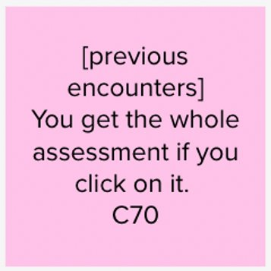
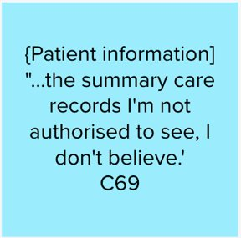
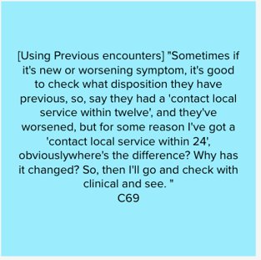
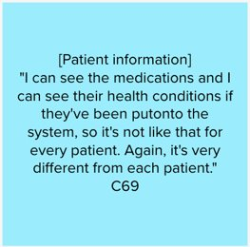
Accessing patient information – Health advisors
Health advisors don't access SCR and GP connect.
The only clinical information that is available to HAs is included in special notes and previous encounters with the service.

Slide 20
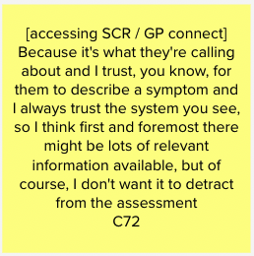
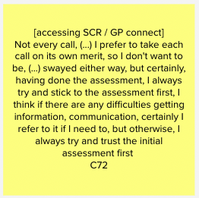
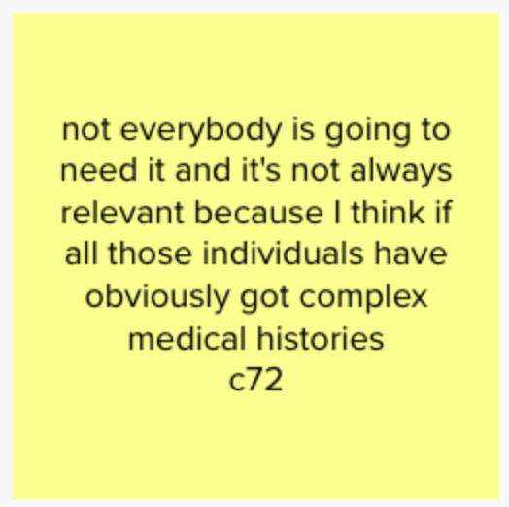
Accessing patient information – 111 clinicians
Clinicians trust the triage system.
Clinicians have access to SCR and GP connect (where available).
Additional patient information is accessed for more complex cases or when patients are unable to disclose information.
One clinician has pointed out that additional information could potentially sway them in a certain direction.

Slide 21
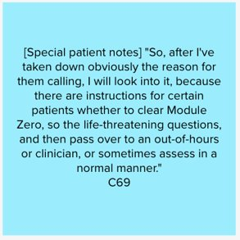
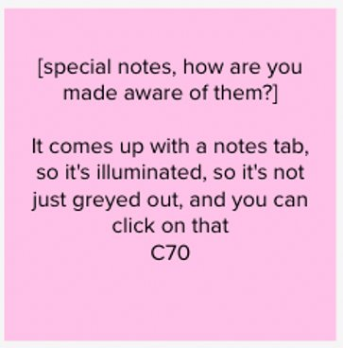
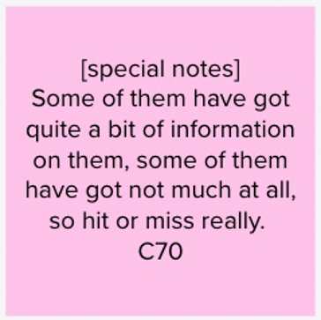
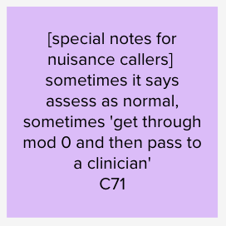
Accessing patient information – Special notes
Special notes are used widely as they include instructions on how to proceed with or manage the call. These may include:
Instructions to immediately pass the caller to a clinician
Long-term conditions
Mental health information
Information about the caller being abusive or aggressive in the past

Slide 22
Frustrations
System-related
Missing patients' records in Summary Care Record and GP Connect tabs
System-driven pop-up windows and notifications. These are being quickly dismissed.
Triage related
Callers not understanding the nature of 111 service and triage process
Callers not seeing the triage questions as relevant
Out of area callers
Appointments cannot be booked for patients accessing services out of the area
Special notes are unavailable for patients out of area

Slide 23
Work-arounds
Observation
A district nurse needed an ambulance for a patient to transport them to the hospital for a check-up of their condition. The patient has multiple health issues, including diabetes. They also had refused to go to a hospital.
The patient's carer was asked by GP to call 999. The carer refused as it wasn't an emergency.
The district nurse had spoken to the patient and they had now agreed to be checked in hospital.
The 111 clinician had to override pathways to get the right ambulance outcome.

Slide 24
Example calls

Slide 25
Overdose of medication
health advisor
A 25-year-old patient diagnosed with Asperger’s was experiencing anxiety and took 19 tablets of his regular medication. They made themselves vomit (a bit) and were not letting anyone near them. The parent was making a call to the 111. They believed this wasn’t a self-harm attempt, but rather an attempt to ease anxiety (if anxiety is bad, I can take more of the tablets) Consultation with a clinician followed by a warm transfer. The HA first discussed what to do (they weren’t sure around vomiting as they remembered that in some overdoes cases you shouldn’t make yourself throw up). The call was marked as ’speak to clinician from the service immediately’. Patient has been put on hold first, the HA saw that there was a clinician they could speak to. They spoke to clinician, then spoke to the patient again and passed onto a clinician.

Slide 26
Repeat prescription – not registered with a GP
Clinician
Hot Transfer
A younger female rang for a repeat prescription of a drug used to treat depression. She had just finished her first prescription of this drug. The patient had recently moved house quickly due to domestic violence and was not yet registered with a local GP surgery. Due to this not yet being a repeat prescription, the advice was to contact a new GP and explain situation and if they couldn't help to call back. The clinician did not look up any information on SCR or other tabs.

Slide 27
Next steps

Slide 28
Next steps
Team session to review feedback and move forward on the next iteration of the prototype
Prototype testing with other 111/CAS settings

